Slide 1
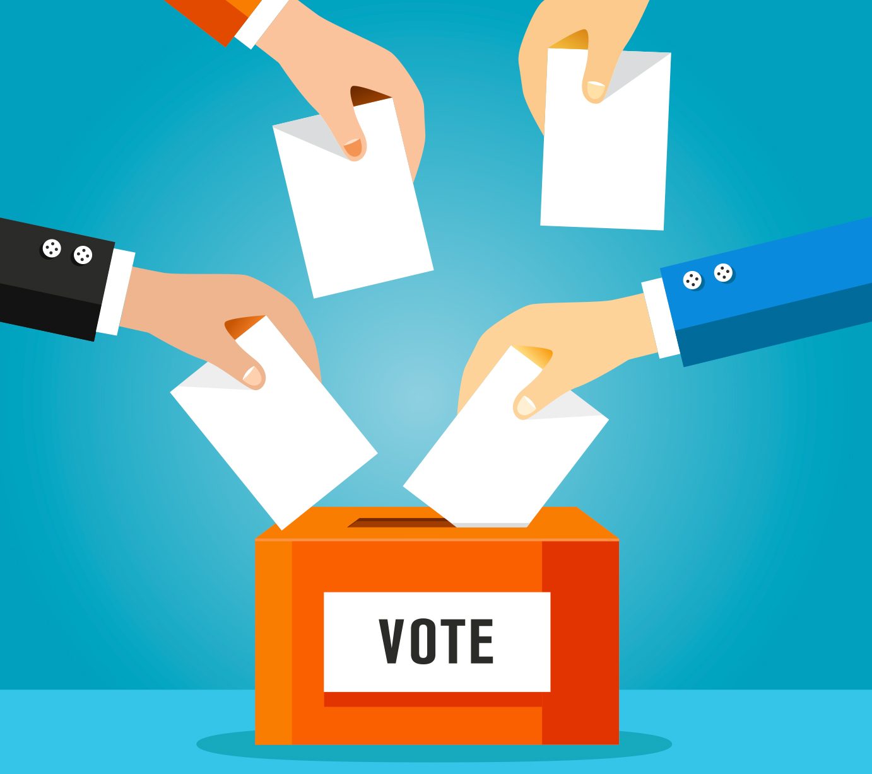
Analysis of 2024 Election Data
Insights into Election Results, Party Performance, and Voter Trends
-By Anutoshi Bhardwaj

Slide 2
Introduction
The 2024 election season has been one of the most anticipated and closely watched in recent history, characterized by dynamic campaigns, evolving voter demographics, and significant political developments. Analyzing the election results is crucial for understanding voter behaviour, regional trends, and the overall political landscape. This project aims to leverage Tableau, a leading business analytics tool, to conduct a comprehensive analysis of the 2024 election results.
Using Tableau, we will visualize and interpret vast amounts of data, enabling stakeholders to gain insights through interactive dashboards and reports. These insights will help political analysts, campaign strategies, researchers, and the general public.

Slide 3
OBJECTIVE:
The objective of this task is to analyze the 2024 election data.
Gain insights into the election results
Party/alliance performance across the states
Voter trends across various constituencies.

Slide 4
STEPS:
Data Integration
Data cleaning and Preparation
Data Analysis and Preparation
Interactive Dashboard
Insights and Recommendations

Slide 5
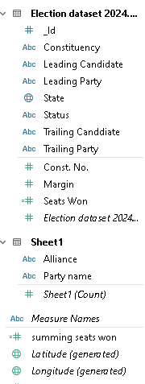
Data Description:
1. Election Results Data:
- `_id`: Unique identifier for each record.
- `State`: Name of the state.
- `Const. No.`: Constituency number.
- `Constituency`: Name of the constituency.
- `Leading Candidate`: Name of the leading candidate.
- `Leading Party`: Name of the leading party.
- `Trailing Candidate`: Name of the trailing candidate.
- `Trailing Party`: Name of the trailing party.
- `Margin`: Vote margin between the leading and trailing candidates.
- `Status`: Status of the election result (e.g., Won, Lost, Leading, Trailing).
2. Party Alliance Data:
- `Party Name`: Name of the political party.
- `Alliance Name`: Name of the political alliance the party belongs to.

Slide 6
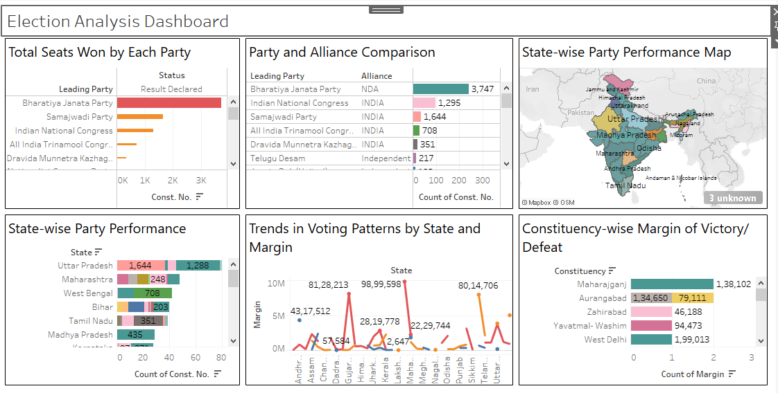
Data Analysis and Visualization:

Slide 7
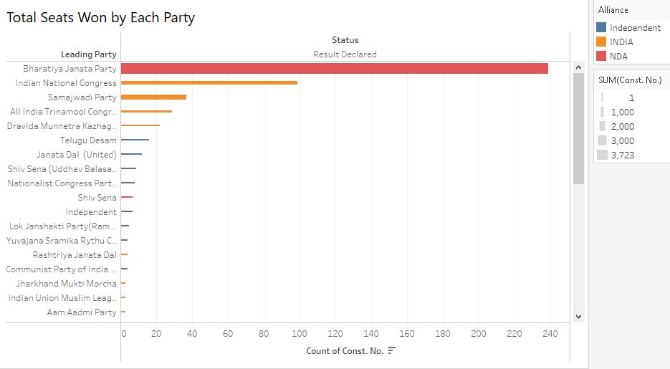


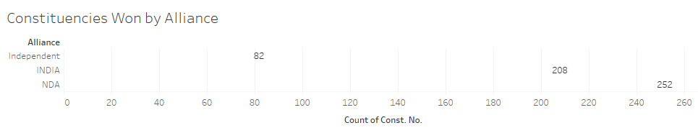
Overall Results:
As per the diagram, we can see that BJP is the leading party with 240 seats and then there is Congress with 99 Seats followed by 37 seats of Samajwadi party and 29 seats of All India Trinamool Congress
Total Seats Won is 542 & Average Margin of win for the candidate Overall is 162.05k
And for the Alliance NDA is 252 seats and INDIA has 208 seats

Slide 8
INSIGHTS:
NDA is the leading alliance with 252 seats. Which is showing they are leading in the elections but they don’t have numbers required(i.e.272) to make the government neither the INDIA alliance which has 208 seats
As per individual party, BJP is the leading party with 240 seats and then there is CONGRESS with 99, seats followed by 37 seats of SAMAJWADI PARTY and 29 seats of ALL INDIA TRINAMOOL CONGRESS
The Average Margin of winning a consistency is 162.05k votes
India Alliance has won in states which has high number of seats such as Uttar pradesh(43), Tamilnadu(37), West Bengal(30)
The seat count of NDA is low in states with high number of seats
The Average win margin of NDA alliance is 187.36k, where as India alliance average win margin is 137.53k.

Slide 9
RECOMMENDATION:
1. For Party A:
Leverage Strengths in Strongholds:
Continue to focus campaign efforts in northern states where Party A has a strong base. Increase outreach and voter engagement in these regions to solidify support.
Expand Reach in Competitive Areas:
Develop targeted strategies to improve performance in competitive states like State W. Invest in local issues and candidate outreach to gain additional votes.
2. For Party B:
Capitalize on Southern Success:
Build on the success in southern states by strengthening alliances and addressing regional issues. Enhance local party presence to maintain a leading position.
Address Urban Voter Concerns:
Analyze the varied margins in urban constituencies and tailor policies to address diverse voter concerns. Focus on urban issues and engage with community leaders.
3. For Independent Parties:
Consolidate Regional Gains:
Focus on consolidating gains in regions where independent parties have made significant inroads. Strengthen local organizations and support networks.
Enhance Visibility and Branding:
Increase visibility through media and public engagement to build a stronger national presence. Develop a clear and appealing platform to attract more voters.
4. For Alliances:
Strengthen Coalitions:
Review alliance strategies and consider strengthening partnerships to increase overall support. Coordinate campaign efforts to present a unified front.
Focus on Swing States:
Allocate resources to swing states with narrow margins to secure additional seats. Use data-driven strategies to target undecided voters.

Slide 10
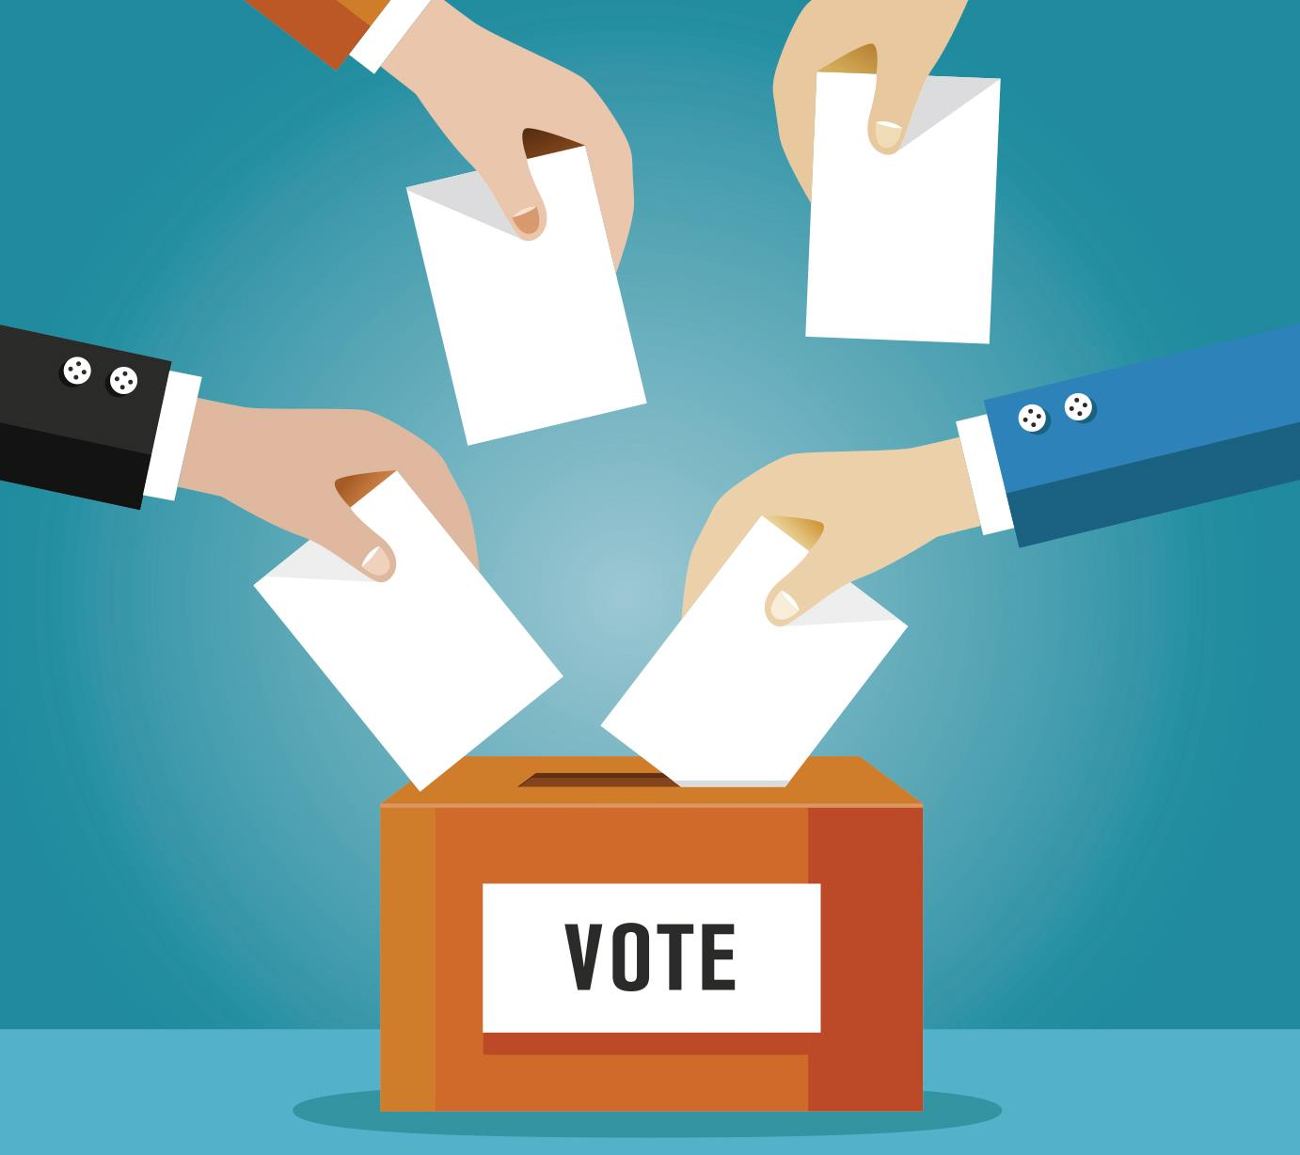
THANK YOU!

